Slide 1
Classes and object-oriented feature
Mr. Mohan Kumar T G
Assistant Professor,
Dept. ISE, NMIT,
Bengaluru

Slide 2
OOP in JavaScript
JavaScript is not a class-based object-oriented language. But it still has ways of using object oriented programming (OOP).
According to Wikipedia, class-based programming is “a style of Object-oriented programming (OOP) in which inheritance occurs via defining classes of objects, instead of inheritance occurring via the objects alone”
The most popular model of OOP is class-based.
But as mentioned, JavaScript isn't a classed-based language – it's is a prototype-based language.
A prototype-based language has the notion of a prototypical object, an object used as a template from which to get the initial properties for a new object.

Slide 3
Example
The object variable names has only two properties - fname and lname.
So where does hasOwnProperty come from?
Well, it comes from the Object Prototype.

Slide 4

Prototype in JavaScript
JavaScript is a prototype based language, so, whenever we create a function using JavaScript.
JavaScript engine adds a prototype property inside a function, Prototype property is basically an object (also known as Prototype object), where we can attach methods and properties in a prototype object, which enables all the other objects to inherit these methods and properties.

Slide 5

The _ _Proto_ _ Property
This points to the object which is used as a prototype.
This is the property on every object that gives it access to the Object prototype Property.
Every object has this property by default, which refers to the Object Prototype except when configured otherwise (that is, when the object’s _ _proto_ _ is pointed to another prototype).

Slide 6
Modifying the _ _Proto_ _ Property
This property can be modified by explicitly stating that it should refer to another prototype. The following method are used to achieve this:
Object.create()
It uses the argument passed to it to become the prototype.

Slide 7

new Keyword
Example
John’s _ _proto_ _ is directed to DogObject’s prototype. But remember, DogObject’s prototype is an object (key and value pair), hence it also has a _ _proto_ _ property which refers to the global Object prototype.
This technique is referred to as PROTOTYPE CHAINING.
Note that: the new keyword approach does the same thing as Object.create() but only makes it easier as it does some things automatically for you.

Slide 8
Object + Function Combination
You are probably confused by the fact that DogObject is a (function DogObject(){} )and it has properties accessed with a dot notation. This is referred to as a function object combination.
When functions are declared, by default they are given a lot of properties attached to it. Remember that functions are also objects in JavaScript data types.

Slide 9
Now Class
JavaScript introduced the keyword in ECMAScript 2015. It makes JavaScript seem like an OOP language. But it is just syntactic sugar over the existing prototyping technique.
It continues its prototyping in the background but makes the outer body look like OOP. We'll now look at how that's possible.

Slide 10
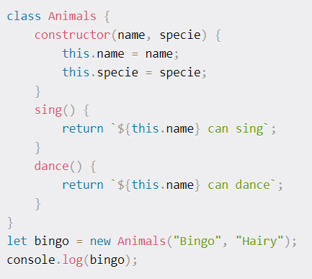
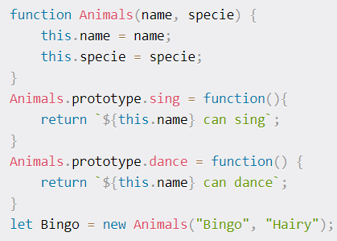
Compare code with new keyword

Slide 11

Subclassing
This is a feature in OOP where a class inherits features from a parent class but possesses extra features which the parent doesn't.
The idea here is, for example, say you want to create a cats class. Instead of creating the class from scratch - stating the name, age and species property afresh, you'd inherit those properties from the parent animals class.
This cats class can then have extra properties like color of whiskers.

